Slide 1

TRAVEL BUDDY
Mediator between travel companies and travellers

Slide 2
TECH FEST
Sampada Kalbande
Ankita Bharambe
Vaishnavi Kale
Pruthviraj Dhale

Slide 3
Abstract
The Travel buddy application efficiently manages the need of travellers and travel companies by connecting them with each other.

Slide 4
Problem Statement
Self planning trip is time consuming and not guided by experts.
Travel companies have perfect itinerary but lacks customers.

Slide 5
Project Overview
Web-based Travel Buddy Application
Designed to solve the problem of traveller and travel company.
Eliminates manual and paper-based itinerary planning.
Supports multiple user roles: Travel company and traveller.
Travel companies can create package and add trips
Travellers can view package, trips, book trip online, and give feedback
Built using React (Frontend), Spring Boot (Backend), MySQL (Database)
Follows microservices architecture with RESTful APIs
Ensures scalability, security, and data integrity
Improves efficiency, transparency, and user experience

Slide 6
Users & Use cases
Traveller Module
1 – Account Creation Process
2 – Login Process
3 – Forgot Password Process
4 – Change Password Process
5 – Search Tour Packages
6 – View Trip
7 – Book Trip
8 – Cancel Trip
9 – Give Feedback

Slide 7
2. Travel Company Module
1 –Registration
2 – Login Process
3– Forgot Password Process
4 – Change Password Process
5 – Update Account Details
6 – Add Package
7 – Update Package
8 – Delete Package
9 – Add Trip
10– View Booking
11 – View Feedback
12 – View Complaint

Slide 8
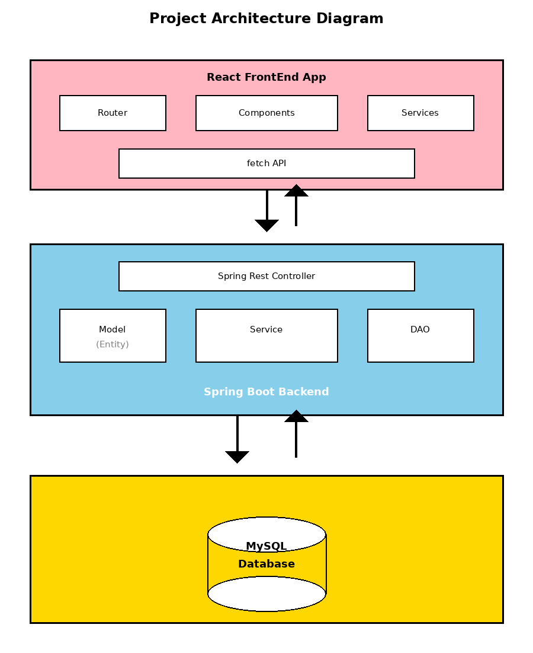
System Architecture

Slide 9
Project Architecture
Front End
Web server
running on
localhost:3000
Middle tier with
Microservices architecture
DB Tier
Using HTML, CSS
Bootstrap
React Js components
Discovery service
API Gateway
Business services
(.NET Services)
Entity Framework
ADO.NET
MySQL
(Springboot services)
JPA, Hibernate, JDBC

Slide 10
Front-end workflow
Front End
Middle tier using
Microservices
DB Tier
Validation failed
3
. Page
. React component
. Validation details and Regex
1
2
Validation successful
4
5
Rest API End point:
/products/update
MySQL
Fetch API / Axio Library
API Gateway
6
GET
Product ID
Product Details etc
Error message
7
localhost: 8080
9
Status
localhost:
3306
Un-handled exceptions
and errors
Show result or
Navigate to another page
8
Error page
10
KNOW-IT, C-DAC ACTS (ATC), Pune

Slide 11

Microservices Architecture and Workflow
Middle Tier using Microservices
localhost: 8081
Discovery service
2
3
0
localhost: 8082
Service A
localhost: 3000
1
0
0
Fetch API / Axio Library
API Gateway
0
localhost: 8083
Service B
6
localhost: 8080
4
localhost: 8084
Step | Actions
0 | All services and API gateway registers themselves with Discovery server
1 | Request from client to API Gateway
2 | API gateway queries Discovery service for service name
3 | API gateway received response from Discovery service
4 | API Gateway forwards request to appriate service
5 | API Gateway received response from service
6 | Response sent to client by API gateway
5
Service C
KNOW-IT, C-DAC ACTS (ATC), Pune

Slide 12
Project Methodology
Followed the Software Development Life Cycle (SDLC) approach
Started with requirement gathering and analysis
Prepared problem statement and system objectives
Designed system architecture using microservices approach
Created database schema with proper normalization
Developed backend services using Spring Boot
Implemented RESTful APIs for frontend–backend communication
Developed frontend using React, HTML, CSS, and Bootstrap
Integrated frontend with backend using Axios / Fetch API
Implemented role-based access control
Performed unit testing and API testing using Postman
Fixed bugs and optimized performance iteratively
Prepared documentation and final presentation for Tech Fest

Slide 13
Architecture
Frontend: React
Backend: Spring Boot
Database: MySQL
Architecture: Microservices

Slide 14
Testing
• Unit Testing
• Integration Testing
• API Testing
• Manual Testing

Slide 15
Future Scope
• Mobile App
• Online Payments
• Analytics Dashboard
• AI-based Recommendations

Slide 16
Conclusion
System ensures efficient, secure, and scalable Travel management.

Slide 17
Thank You
Questions?

